Slide 1
TECH SHOP
Under Guidance Of
POOJA MEHTA
SUBMITTED BY
Kevin
Karan
Vignesh Prabu

Slide 2
INTRODUCTION
Online shopping is the process of ordering product with various brands and Variety of design through the website of the shop. The product can be either ready to start despite the lack of personal interaction. The software provides online customers with the same features someone visiting the shop or ordering on the phone would have this includes access to the entire products with full customization.

Slide 3
PROJECT OBJECTIVE
To evaluate the way of interaction with customers.
To develop a Electronics Product ordering system with web application based on the client server application.
To determine the factors that influence customer when ordering Product Through online.

Slide 4
TECHNOLOGIES USED
Spring Boot
Postman
MySQL
Angular

Slide 5
REQUIRED SPECIFICATIONS
Hardware Configuration
Operating System: Windows 10
Hard Disk: 1 TB
RAM: 4GB
Software Configuration
Software IDE: Spring Tool Suite
Language: Java
Front End: Angular
Back End: MySQL ,Postman
Hardware Configuration

Slide 6
SPRING ANNOTATIONS
@Controller :The @Controller annotation indicates that a particular class serves the role of a controller. Spring Controller annotation is typically used in combination with annotated handler methods based on the @RequestMapping annotation.
@Autowired: The @Autowired annotation provides more fine-grained control over where and how autowiring should be accomplished.
@RequestMapping : @RequestMapping is one of the most common annotation used in Spring Web applications. This annotation maps HTTP requests to handler methods of MVC and REST controllers.
@Entity:The Entity annotation specifies that the class is an entity and is mapped to a database table.

Slide 7
SPRING ANNOTATIONS
@Table: The Table annotation is used to create a table in database.
@JoinColumn: @JoinColumn is used to specify a column for joining an entity association or element collection.
@PutMapping :@PutMapping is used for update the records.
@PostMapping: @PostMapping is used to create a resource Mapping.
@GetMapping: @GetMapping is used to read all the inserted records.
@DeleteMapping : @DeleteMapping is used to delete the records.
@PathVariable: The Path Variable annotation is used to extract the value from the URL.
@RequestParam: @RequestParam annotation is used to read the form data and bind it automatically to the parameter present in the provided method.

Slide 8
SPRING ANNOTATIONS
@Request Body: The @RequestBody annotation is applicable to handler methods of spring controller. spring should deserialize a request body into an object.
@OneToOne Mapping: The @OneToOne JPA annotation is used to map the source entity with the target entity, Hibernate maps the tables in your database to the Entity classes in your application.
@OneToMany Mapping:OneTo-Many relationship between table A and table B indicates that one row in a table A link to many rows in table B.but one row in table B links to only one row in table A.
@ ManyToOne Mapping: @Many-to-One mapping means that many instances of this entity are mapped to one instance of another entity.

Slide 9
SPRING VALIDATION
@ExceptionHandler:The @ExceptionHandler is an annotation used to handle the specific exceptions and sending the custom responses to the client.
@ControllerAdvice: A controller advice allows you to use exactly the same exception handling techniques but apply them across the whole application, not just to an individual controller. You can think of them as an annotation driven interceptor.

Slide 10
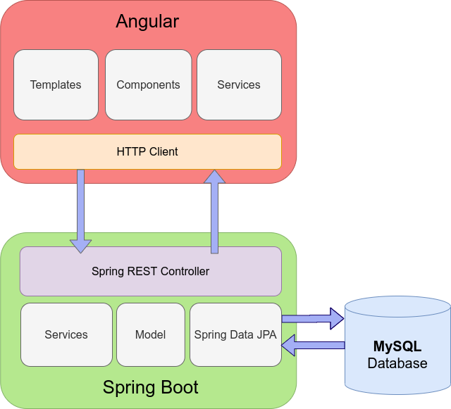
SYSTEM FLOW DIAGRAM

Slide 11
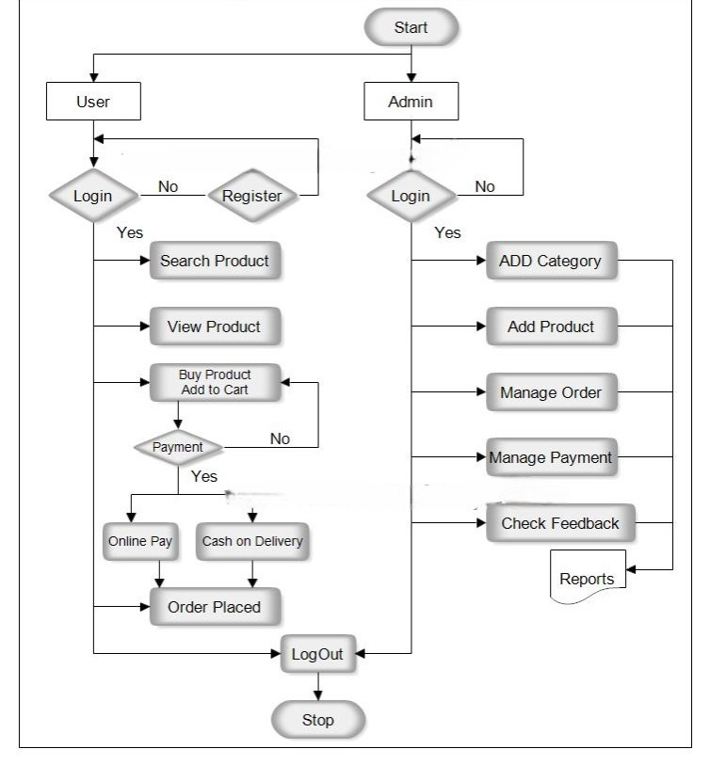
USECASE DIAGRAM

Slide 12
MODULES
The system contains 5 Modules
ADMIN - Registration and Login.
CLIENT - Signup and Login.
MENU LIST - Add/Edit Product by Admin.
CART - Customer can add product from menu list
ORDER - It shows products which present in cart and order status.

Slide 13
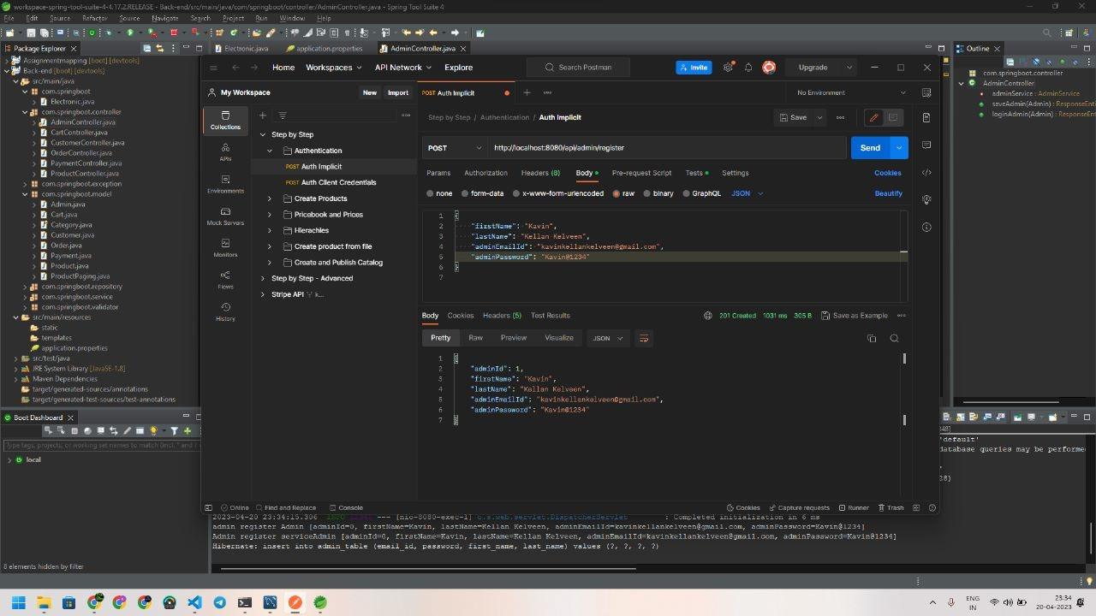
OUTPUT SCREENSHOTS ADMIN REGISTRATION IN POSTMAN

Slide 14
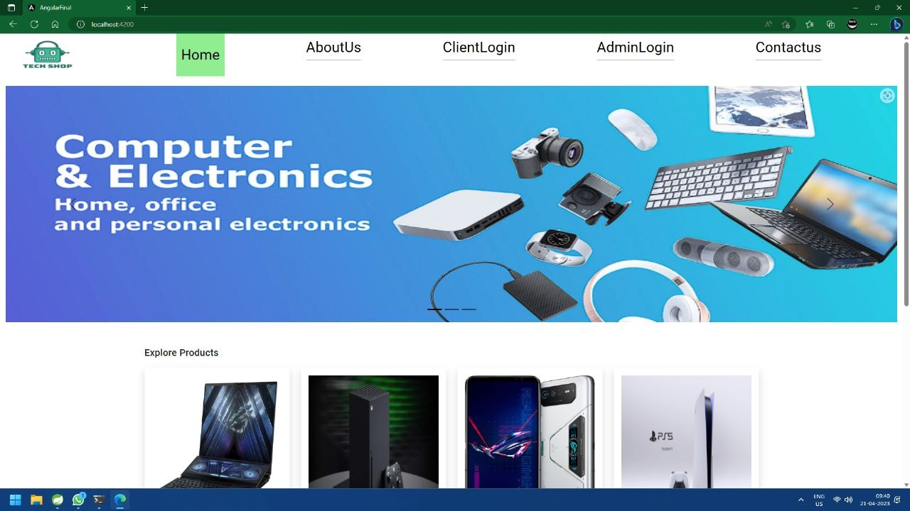
HOME PAGE

Slide 15
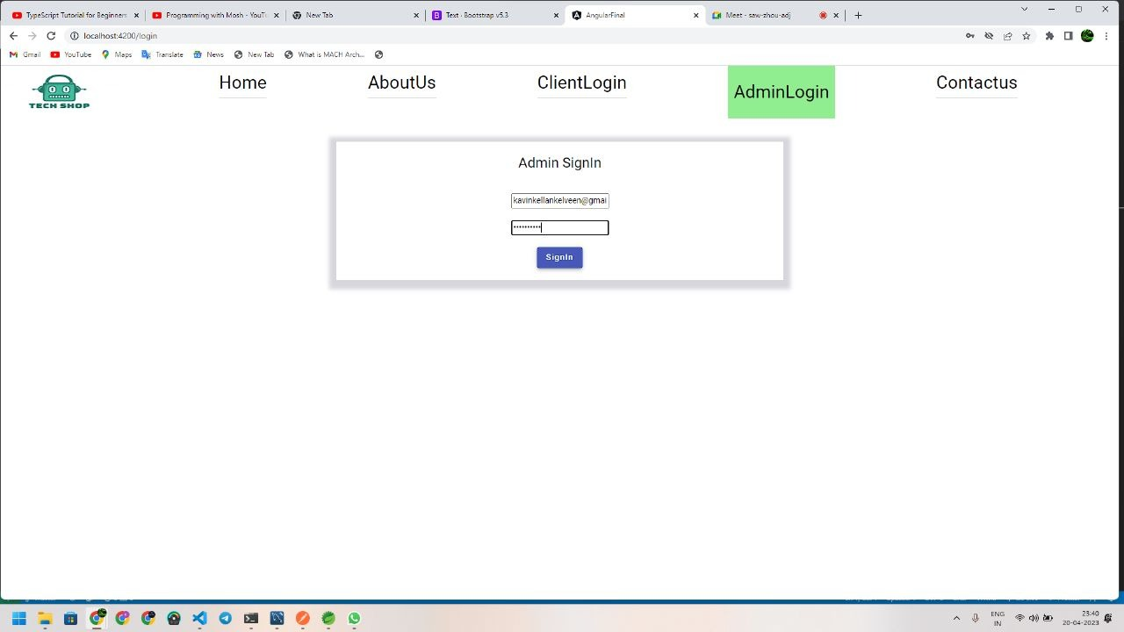
ADMIN MODULE

Slide 16
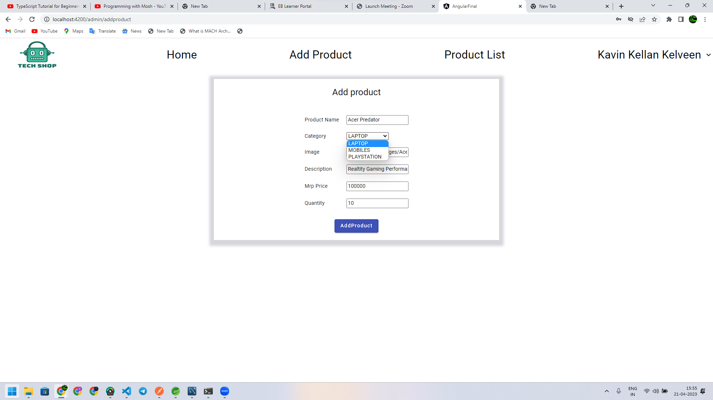
ADMIN MODULE-ADD PRODUCT

Slide 17
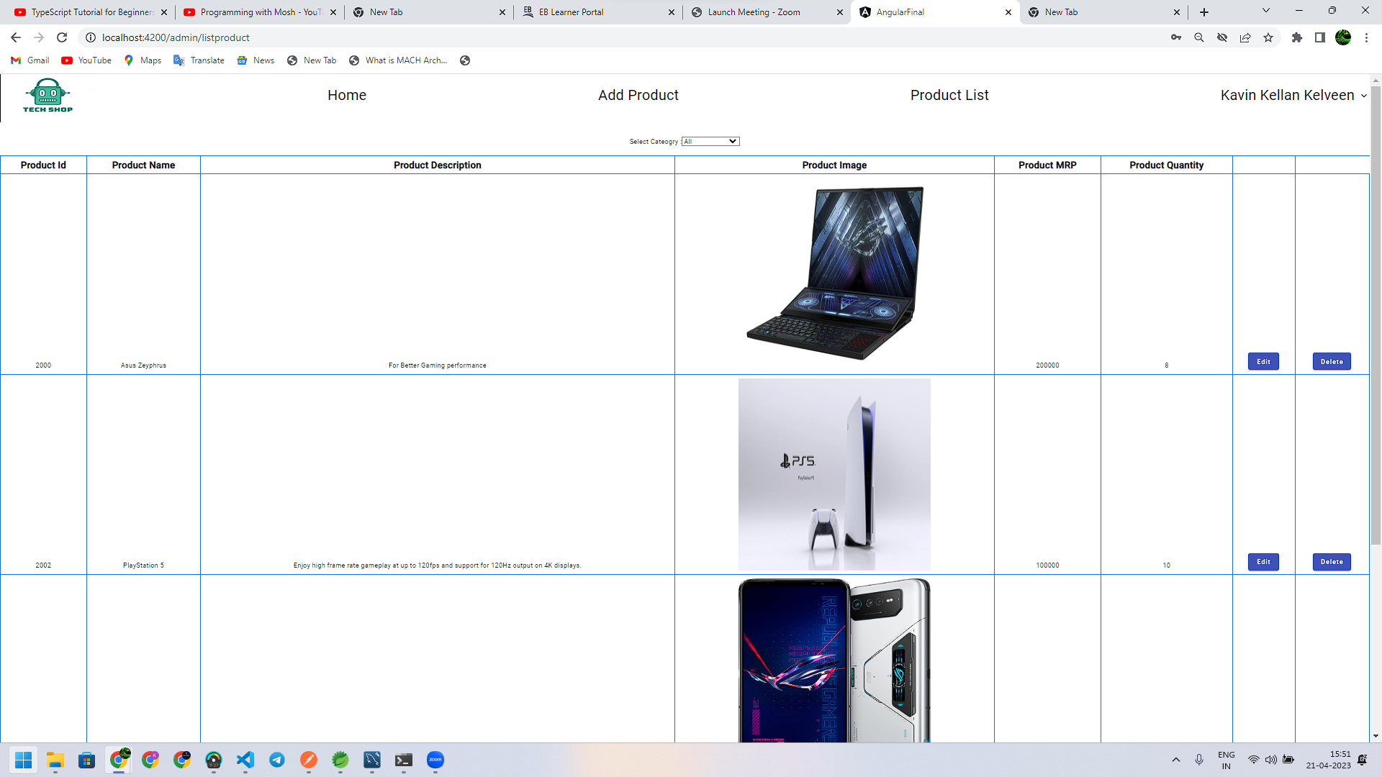
PRODUCT LIST

Slide 18
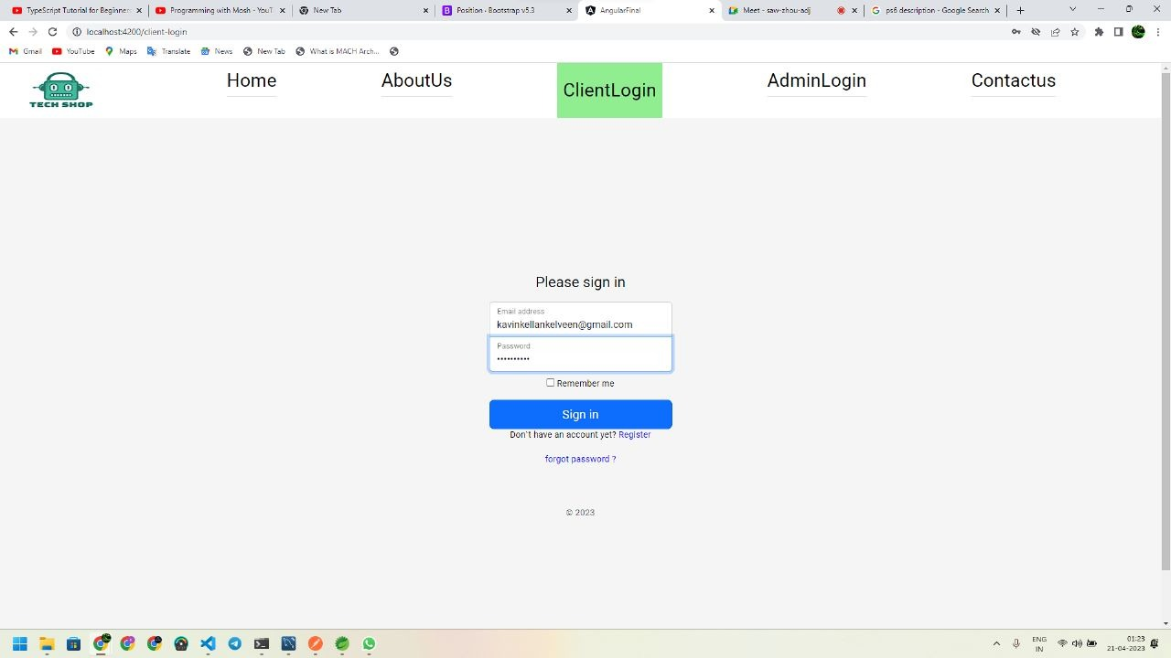
CLIENT LOGIN

Slide 19
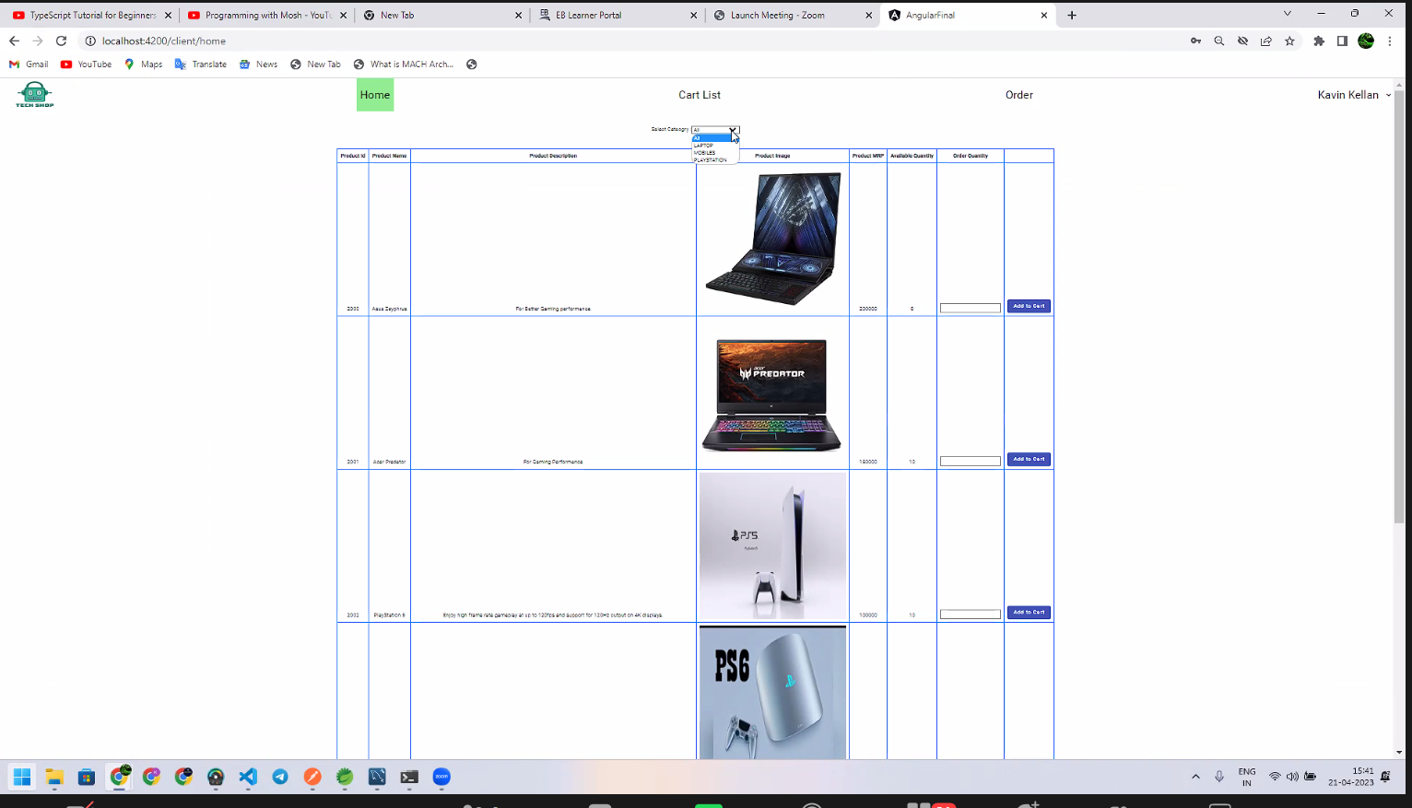
PRODUCT

Slide 20
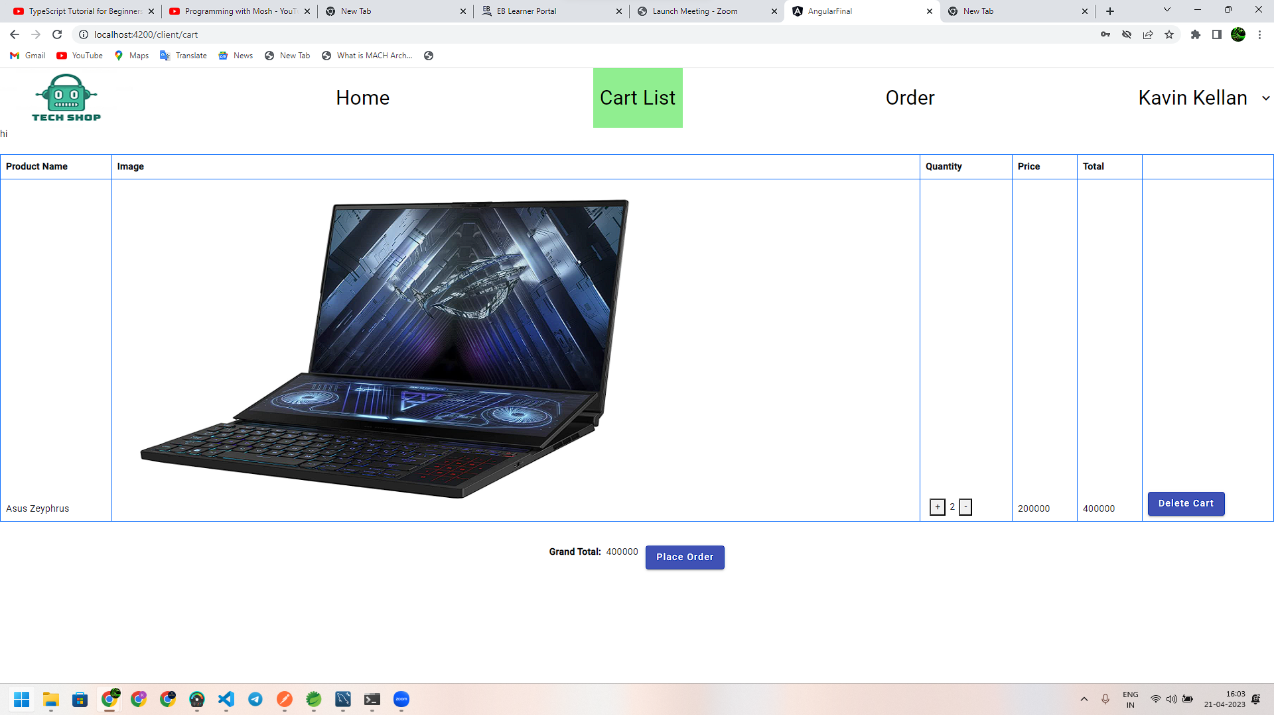
CART LIST

Slide 21
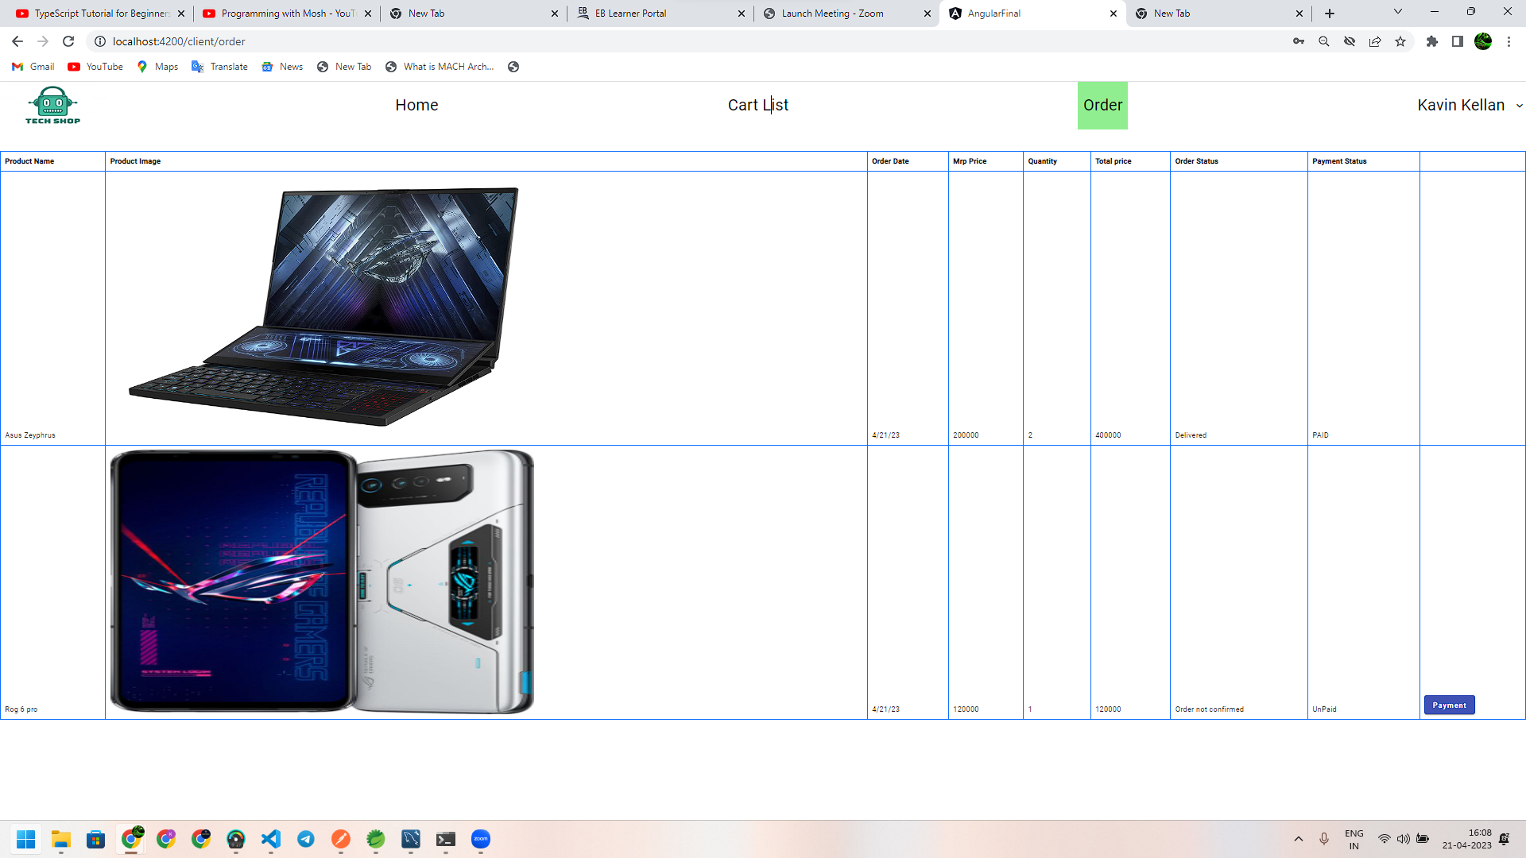
ORDER LIST

Slide 22
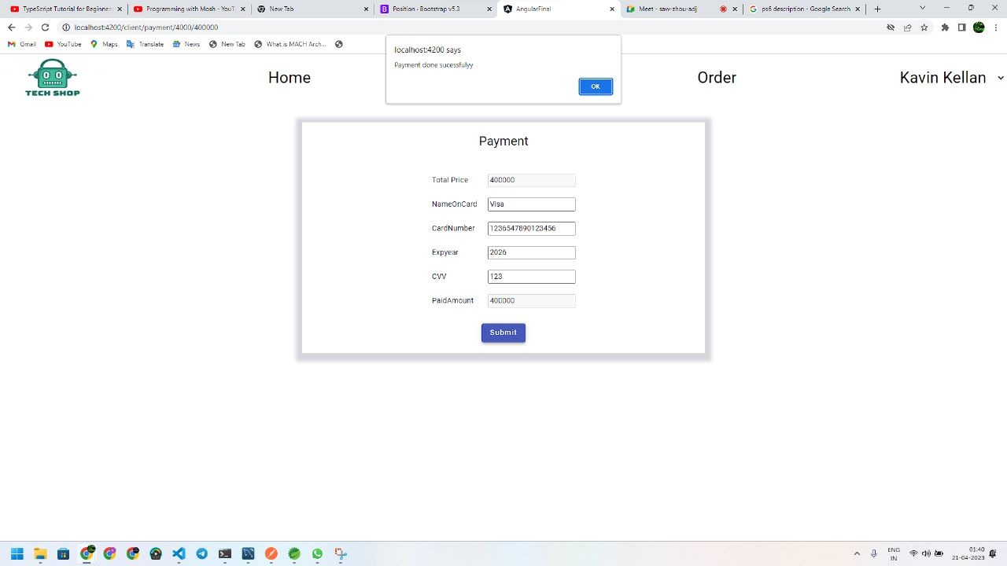
PAYMENT

Slide 23
ADVANTAGES
Clients can order whenever they want..
Makes the ordering process easier.
Customer's satisfaction.
The convenience of mobile ordering
No more waiting in long queues to place an order.
Discover New Products.

Slide 24
CONCLUSION
Online Tech product Ordering system is done to help and solve one of the important problems of customer. Because Large number of customer can use the internet and phone. Various issues related to varity of product availability and different brand can solved by these system .Thus, implementation of online tech system is done to help and solve one of the important problems of customer. It helps customer in making order easily and gives information needed in making order to customer place.

Slide 25
THANK YOU

